Slide 1

III. Types of Chemical Reactions
(p. 256 - 267)
Ch. 8 – Chemical Reactions

Slide 2
A. Combustion
the burning of any substance in O₂ to produce heat
A + O₂ → B
2Mg(s) + O₂(g) ➔ 2MgO(s)
CH₄(g) + 2O₂(g) → CO₂(g) + 2H₂O(g)

Slide 3
A. Combustion
Products:
  Contain oxygen
  Hydrocarbon combustion forms CO₂ + H₂O
Na(s)+ O₂(g) →
Na₂O(s)
4 2
C₃H₈(g)+ O₂(g) →
CO₂(g)+ H₂O(g)
5 3 4

Slide 4
Combustion Reaction
http://www.marymount.k12.ny.us/marynet/stwbwk05/05flashchem/lyreaction/lyreaction.html

Slide 5

B. Synthesis(Combinations)
the combination of 2 or more substances to form a compound
only one product
A + B → AB

Slide 6
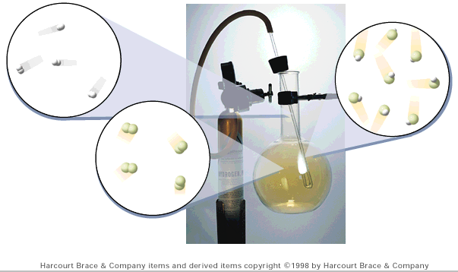
B. Synthesis (Combination)
H₂(g) + Cl₂(g) → 2HCl(g)

Slide 7
B. Synthesis (Combination)
Products:
  ionic formula units - cancel charges (CRISS-CROSS)
  covalent molecules - hard to tell
Al(s)+ Cl₂(g) →
AlCl₃(s)
2 3 2

Slide 8

C. Decomposition
a compound breaks down into 2 or more simpler substances
only one reactant
AB → A + B

Slide 9
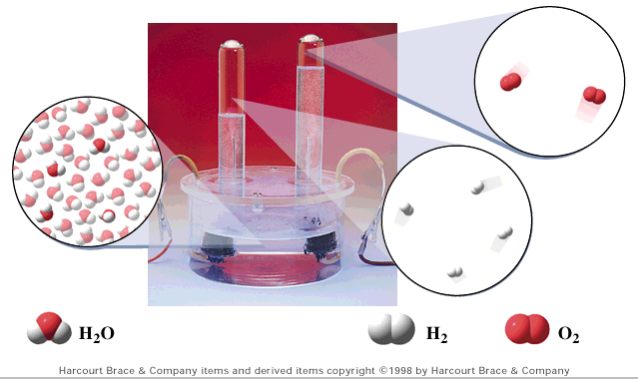
C. Decomposition
2 H₂O(l) → 2 H₂(g) + O₂(g)

Slide 10
C. Decomposition
Products:
  Binary compounds - break into elements
  others - hard to tell
KBr(l) →
K(s) + Br₂(l)
2 2

Slide 11
Decomposition Resulting in the Formation of a Compound and an Element
http://www.marymount.k12.ny.us/marynet/stwbwk05/05flashchem/mnreaction/reaction.html

Slide 12

D. Single Replacement
one element replaces another in a compound
  metal replaces metal (+)
  nonmetal replaces nonmetal (-)
A + BC → B + AC

Slide 13
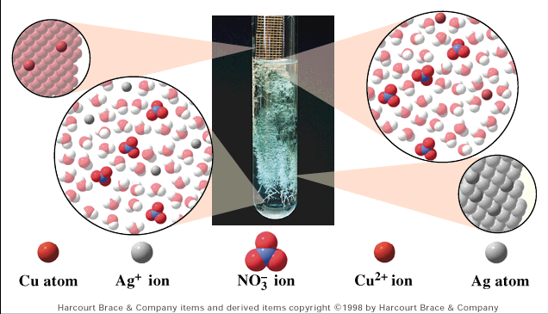
D. Single Replacement
Cu(s) + 2AgNO₃(aq) → Cu(NO₃)₂(aq) + 2Ag(s)

Slide 14
D. Single Replacement
Products:
  metal → metal (+)
  nonmetal → nonmetal (-)
  free element must be more active (check activity series)
Fe(s)+ CuSO₄(aq) →
Cu(s)+ FeSO₄(aq)
Br₂(l)+ NaCl(aq) →
N.R.

Slide 15
Mg(s) + 2HCl →MgCl 2(aq) + H2(g)
http://www.marymount.k12.ny.us/marynet/stwbwk05/05flashchem/avreaction/avreaction.html

Slide 16
Single Replacement Involving a Metallic Element
http://www.marymount.k12.ny.us/marynet/stwbwk05/05flashchem/gbreaction/reaction.html

Slide 17

E. Double Replacement
ions in two compounds “change partners”
cation of one compound combines with anion of the other
AB + CD → AD + CB

Slide 18
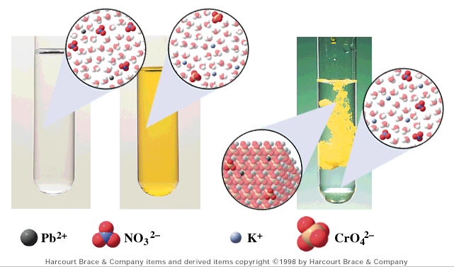
E. Double Replacement
Pb(NO₃)₂(aq) + K₂CrO₄(aq) → PbCrO₄(s) + 2KNO₃(aq)

Slide 19
E. Double Replacement
Products:
  switch negative ions
  one product must be insoluble (check solubility table)
Pb(NO₃)₂(aq)+ KI(aq) →
2 2
PbI₂(s)+ KNO₃(aq)
NaNO₃(aq)+ KI(aq) →
N.R.

Slide 20
Double Replacement: Evolution of a Gas
http://www.marymount.k12.ny.us/marynet/stwbwk05/05flashchem/isreaction/reaction.html

Slide 21
Double Replacement Reaction
Involving a Polyatomic Ion and Producing a Precipitate
http://www.marymount.k12.ny.us/marynet/stwbwk05/05flashchem/kereaction/reaction.html

